Slide 1
Taxi Trip Pricing at Chicago --- Final Project of Applied Data Science Capstone by IBM
Mar 2020
Chao Wang

Slide 2
Background of Predicting Taxi Trip Cost
Taxi is one of the most important urban trip method
When we are planning a trip riding Uber or Lyft vehicle, we can see an estimated price if we try navigation APPs like Google Map
Market of rideshare is dominated by Uber and Lyft by 2018, the market share in reimbursement of taxi decreased to 5.2% by Q2 of 2018
Question:
How to estimate the taxi trip cost?

Slide 3
Data Source and Cleaning
By using the taxi trip data from https://data.cityofchicago.org/Transportation/Taxi-Trips/wrvz-psew (>70GB)
Split into subsamples by year using SAS, select stratified split sample 2018 for Train and Validate set and sample 2019 for Testing, assuming limited annual effect between these 2 years.
Including independent variables of:
Starting and Ending coordinates (Longitude and Latitude), Time (Trip_Seconds) and Distance (Trip_Miles)
Fixed Effects: Month, Weekday, Hour_Bracket
Cleaning data by removing records with outlier price and time, the dataset includes only trips start & end in the city of Chicago
The neighborhood code of Chicago has been matched with the community area list https://en.wikipedia.org/wiki/Community_areas_in_Chicago

Slide 4
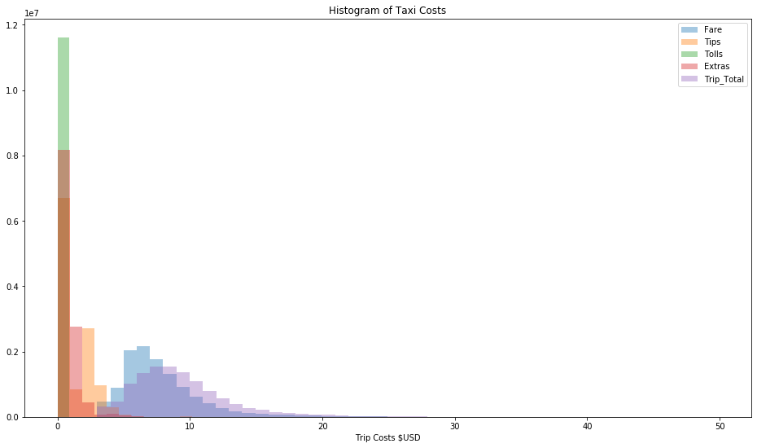
Taxi Cost Distribution
Collected from sample data 2018, including more than 20 million data rows
The Total cost of trips has a peak of distribution of around $7-8, the mode of Fare is at around $5-6

Slide 5
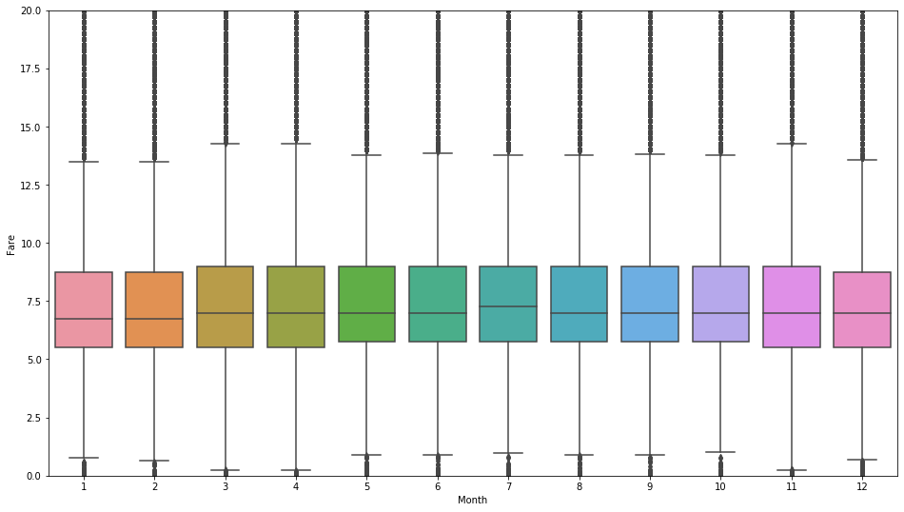
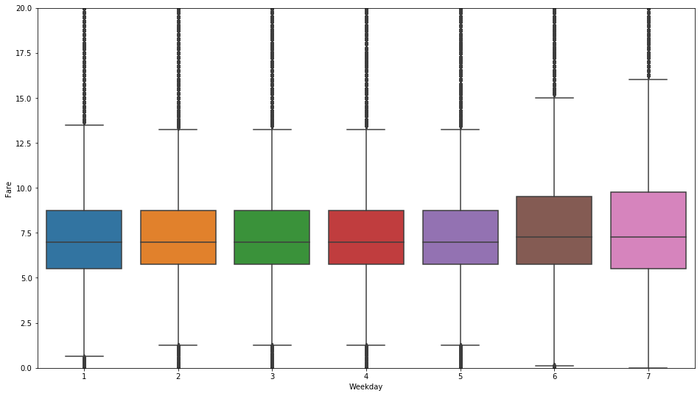
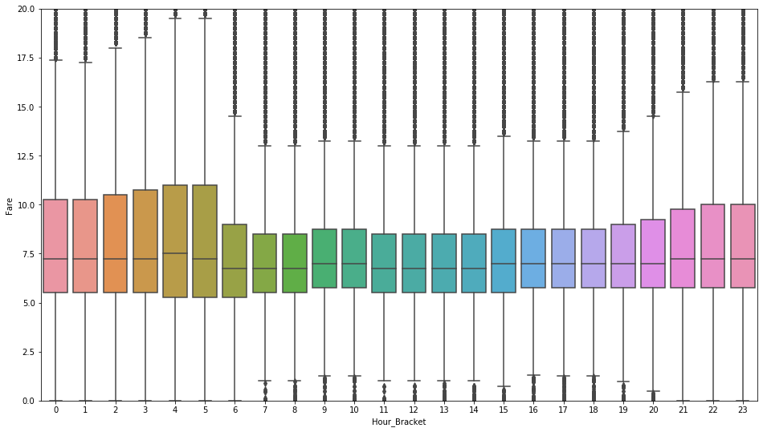
Fare Box-Plot by Fixed Effects
Month, Weekday and Hour Bracket have been considered, it is apparently the trip price by weekday and hour bracket varies a lot.
They are further considered to be recoded in the predictive model.

Slide 6
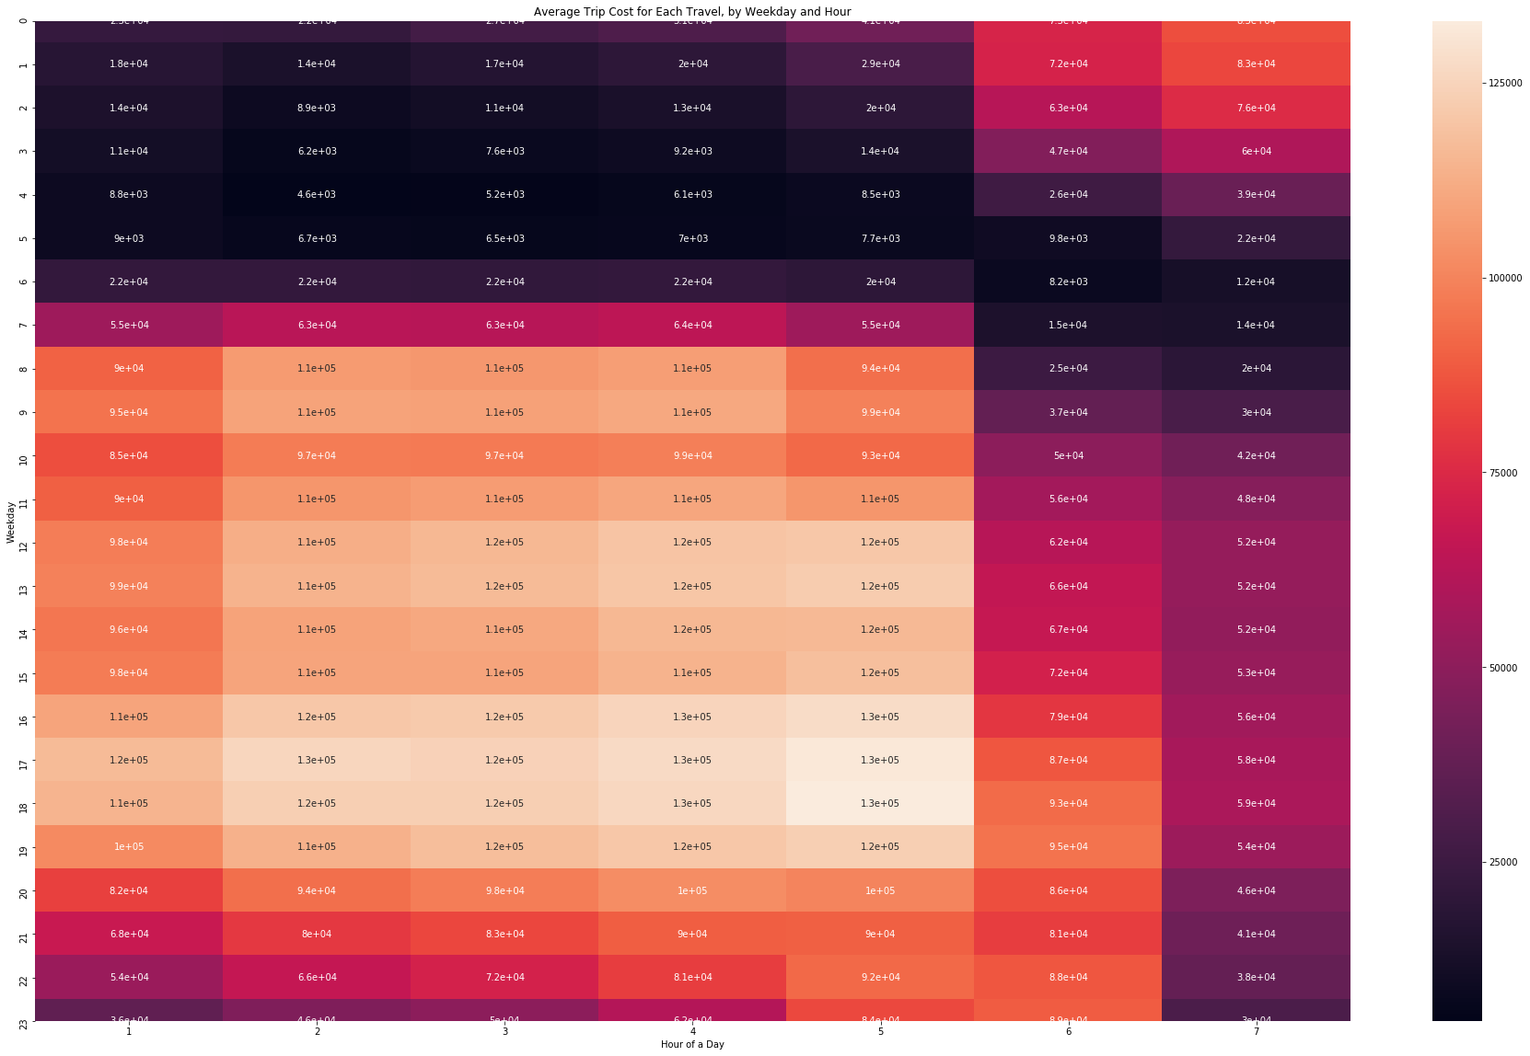
Trip Frequency by Weekday and Hour Bracket
It is clear from the heat table taxi trips are more frequent in daytime on weekdays and over night during weekend

Slide 7
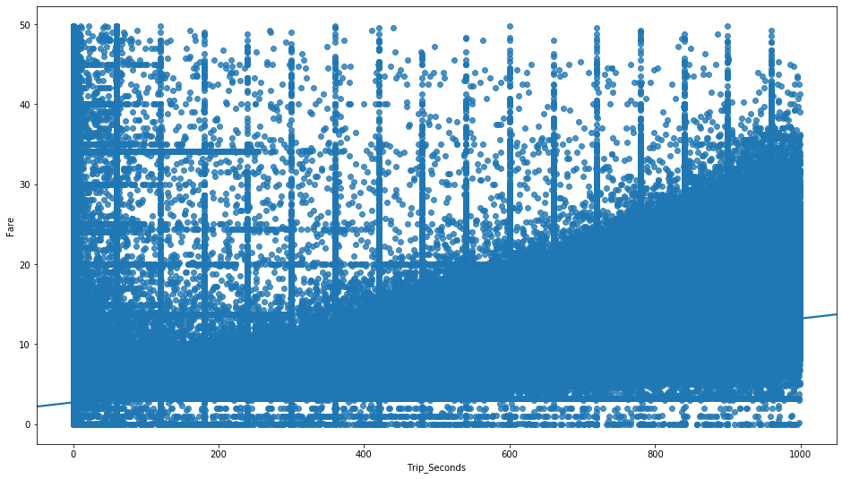
Trip Cost and Time
Both Trip cost and time are unknown before the trip, and there is no surprise they are highly correlated at 0.76.
Although the data set includes trip cost and time, they are not going to be considered to predict each other, both of them can be dependent variable in the taxi trip project

Slide 8
Prediction Models
By using absolute difference between coordinates, trip distance and One-Hot Encoding (0, 1) fixed effects to predict the trip cost:
Random Forest (Best fit, without fixed effects)
Root Mean Square Error = 2.37 (Valid), 2.52 (Test)
Linear Regression (Best fit, with One-Hot Encoding fixed effects)
Root Mean Square Error = 2.92 (Valid), 3.02 (Test)
The Random Forest model performed slightly better than linear regression, and there is room to have better prediction by adding more features to the model, more than just coordinates and distance.

Slide 9
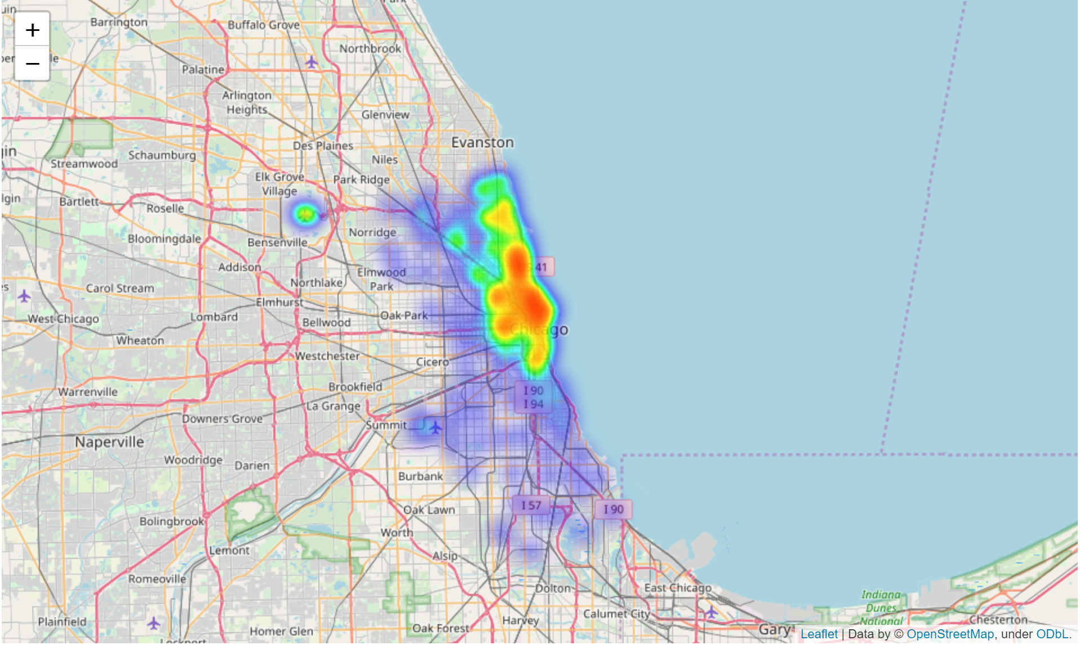
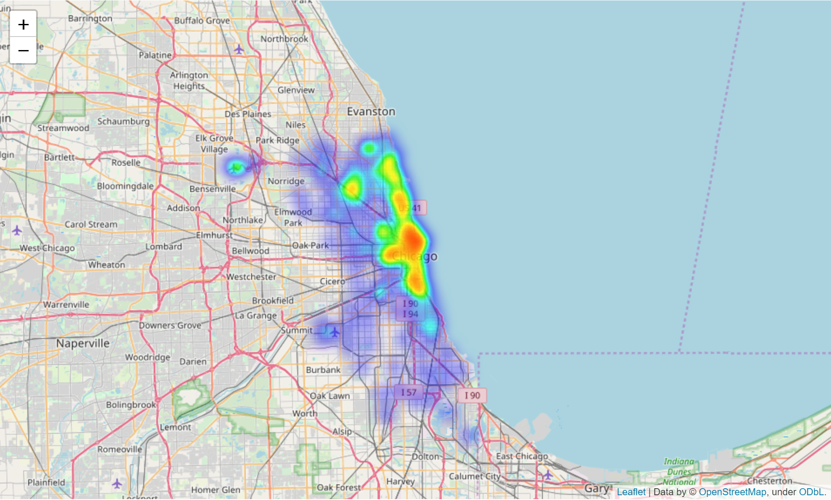
Heat Map of Trips’ Origin
The upper right graph is the heat map of taxi trip start Saturday night
The lower right graph is the heat map of taxi trip start Monday morning
The origin in weekday are mainly business trips in Downtown which aggregated the most companies’ head quarters at Chicago; by contrast, weekend taxi trips are more spread out the city, its north leg is the shopping and entertainment center of Chicago the north Michigan Ave --- Magnificant Mile

Slide 10
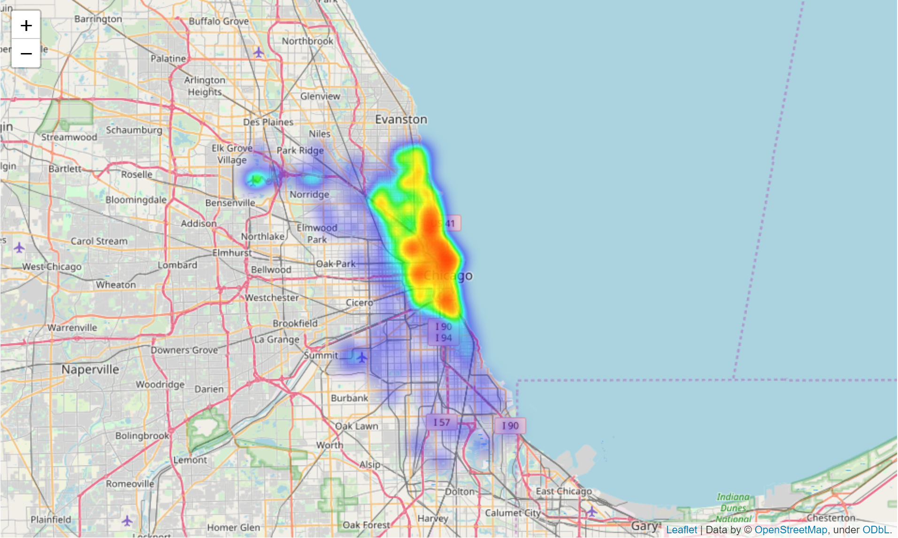
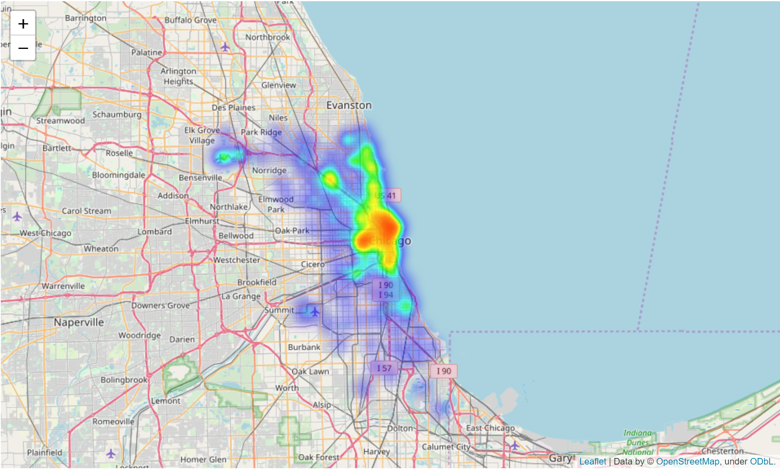
Heat Map of Trips’ Terminal
The upper right graph is the heat map of taxi trip target Saturday night
The lower right graph is the heat map of taxi trip target Monday morning
The target in weekday and weekend are similar with the heat map of their origin, especially the Saturday night group, the trip target is spread out the city.

Slide 11
Conclusion and Future Study
It is doable to predict taxi trip cost or time by using information including start/end coordinates, trip estimated distance and useful fixed effects like weekday, hour bracket, etc.
There is room to improve the model in this project.
More important information to improve the predictive accuracy can be:
Traffic information, pricing function by each taxi company, etc.
Use more detailed fixed effects rather than only using large scale community area as geographic effects if given more capacity of computing.
The project suggests people have different demand for traveling in different time period, if taxi companies want to compete with Uber/Lift, they should figure out optimal strategies and intelligent booking system for taxi drivers rather than letting them all wait around buildings in line.

